Slide 1
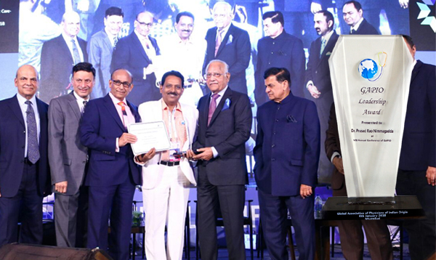

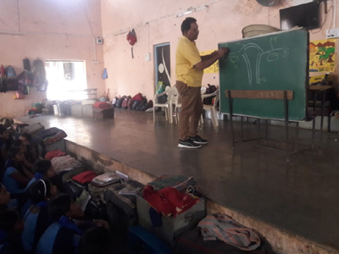
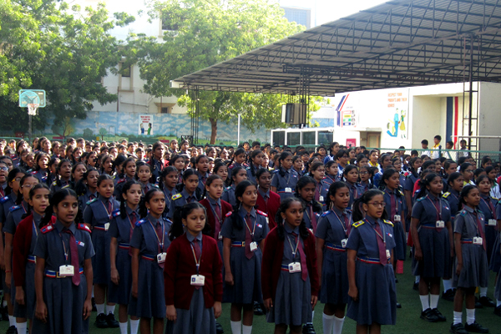
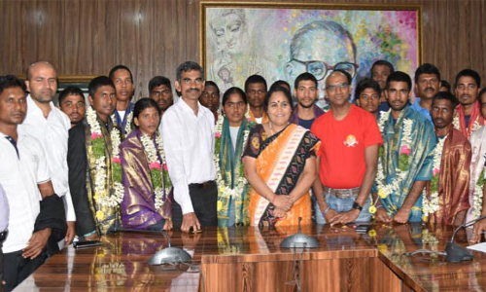
Tribal Welfare
Residential Schools
Chhattisgarh
Prepared by:
Nilesh Singhania
NIT Raipur

Slide 2
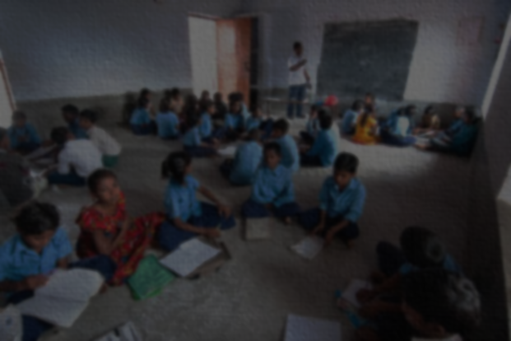
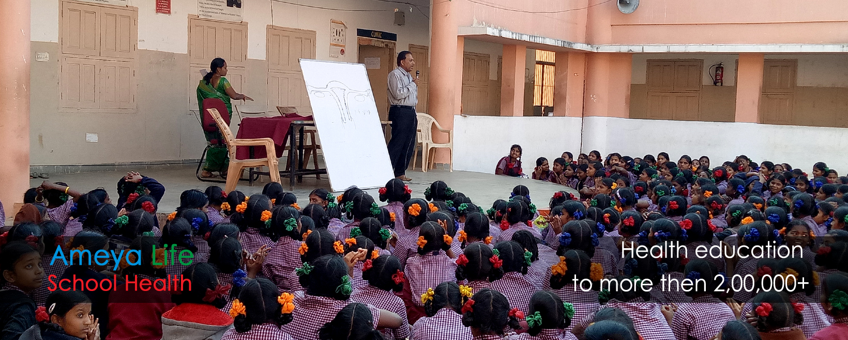
INTRODUCTION
Ekalavya Model Residential School (EMRS) is a Government of India scheme for model residential school for Indian tribals (Scheduled Tribes, ST) across India. It was established by the Tribal Ministry, Government of India.
Similarly, Ameya life is an innovative healthcare delivery company which provides quality healthcare to a diverse population through a variety of service lines with special focus on prevention of non communicable diseases(NCD’s) and promotion of healthy lifestyle.

Slide 3
District wise literacy rate of ST (Chhattisgarh)
With the establishment of tribal welfare residential schools, different ERMS, school health services of Ameya life; literacy rate of tribes has shown a significant increase.

Slide 4
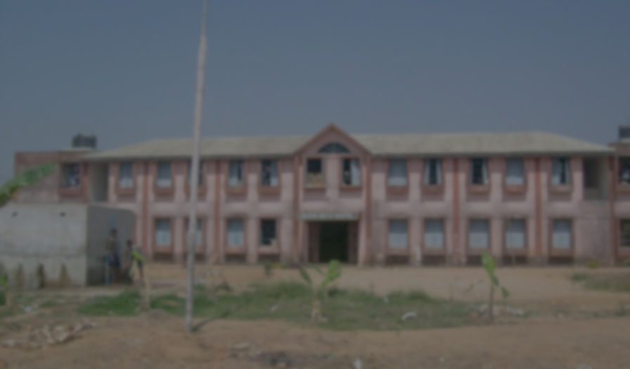
Number of students enrolled in Tribal welfare residential schools.
Districts | Students
bastar | 400
dantewada | 244
jashpur | 410
kanker | 395
kabirdham | 360
raigarh | 360
surajpur | 385
surguja | 327
bijapur | 284
korba | 290
rajnandgaon | 392
koriya | 335
kondagaon | 97
bilaspur | 59
narayanpur | 110
Districts | Students
balod | 56
balrampur | 60
bastar | 163
dhamtari | 60
gariyaband | 40
janjgir champa | 55
mahasamund | 54
mungeli | 60
sukma | 60
baloda bazar | 52
Number of students enrolled
Districts

Slide 5
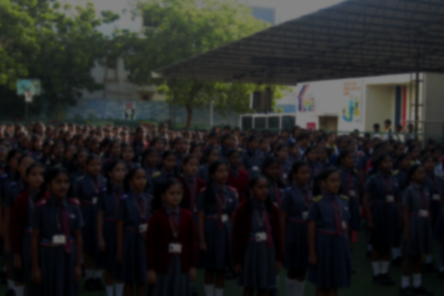

Ameya Life School Health Services
Creation & maintenance of a cloud based electronic health record for each student.
Appropriate referral for detected disorders to our empaneled hospitals and clinics.
Availability of expert guidance on a toll free number for health advice and referral by the team.
Screening and promotion of health among staff.
Health screening for students at school.
Healthy / Safe Environment Services
Component for nutrition instruction and planning.

Slide 6
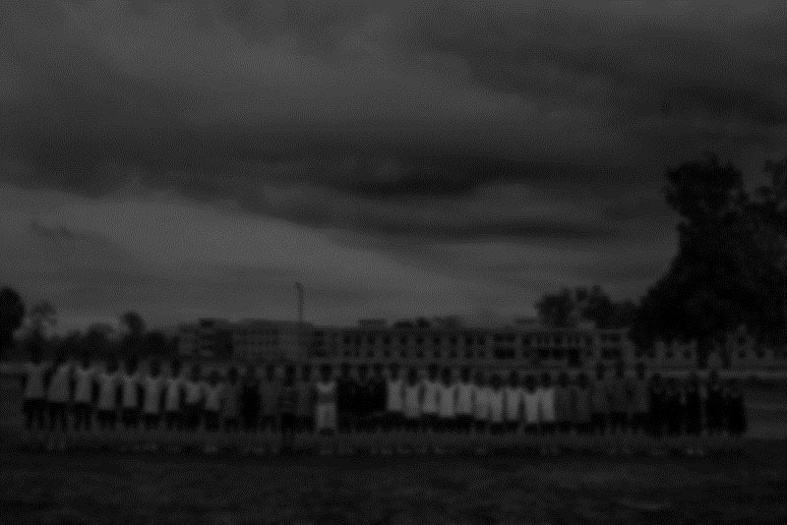
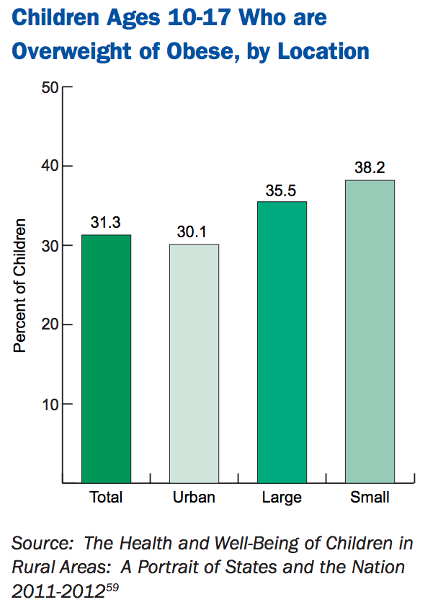
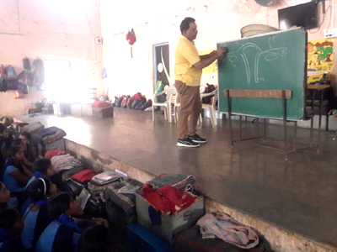
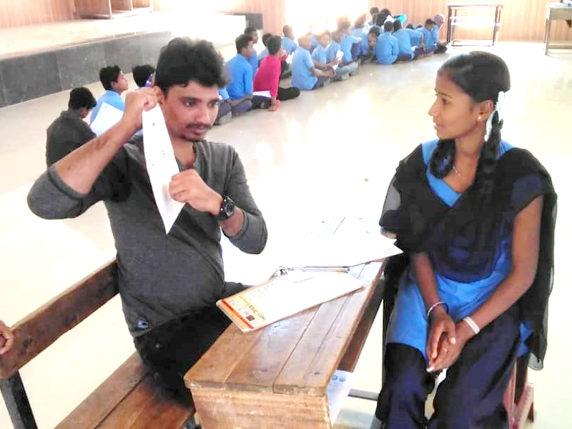
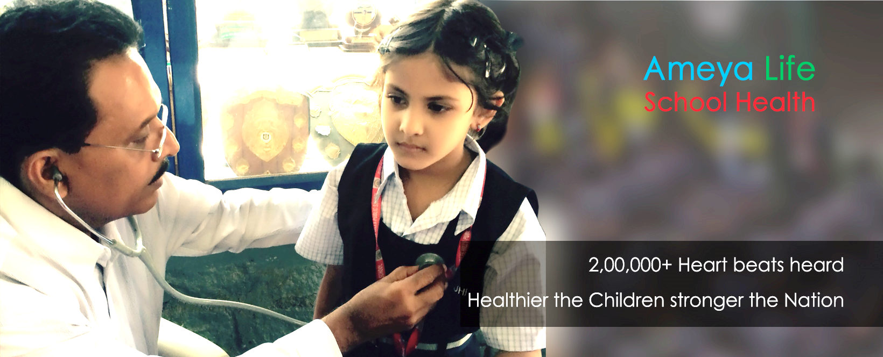
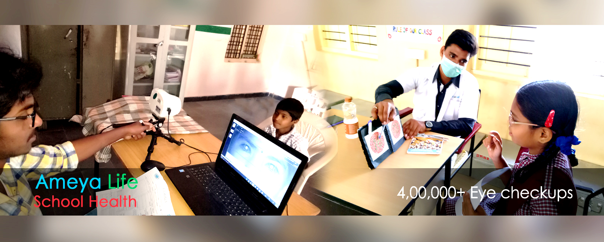
IMPROVEMENT STATISTICS
A recent study on urban Indian school children showed that there was an improvement in behavior & knowledge of about 40-70% among school children after medical education for prevention of obesity & diabetes.
Some more facilities:
Due to such organisations, not only urban but also large as well as small towns’ children have shown improvement

Slide 7
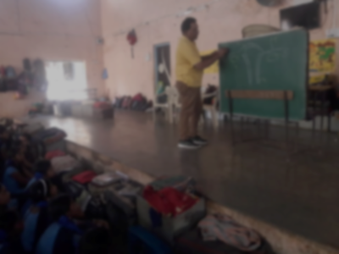
REFERENCES
http://tribal.cg.gov.in/en/scheduled-areas
https://www.google.com/search?rlz=1C1CHBF_enIN838IN838&ei=zMvlXJTjNZWS9QOuioqQDA&q=district+wise+growth+in+tribal+residential+schools&oq=district+wise+growth+in+tribal+residential+schools&gs_l=psy-ab.3..35i39.139452.139452..139964...0.0..0.200.200.2-1......0....1..gws-wiz.......0i71.m8p0g49XpNc
https://www.indiastat.com/social-and-welfare-schemes-data/27/tribal-schemes/285/scheme-of-ashram-schools-1994-2018/368234/stats.aspx
https://tribal.nic.in/DivisionsFiles/sg/ListEMRS060418.pdf
https://data.gov.in/resources/district-wise-girls-and-boys-hostels-students-belonging-scheduled-tribes-chhattisgarh
https://data.gov.in/resources/state-wise-details-functional-eklavya-model-residential-schools-emrss-and-number-students
http://ameyalife.com/
https://en.wikipedia.org/wiki/Eklavya_Model_Residential_School
http://www.ipeglobal.com/downloads/publications/Residential-School-Report-13-01-16.pdf

